Slide 1
COSTUME DESIGN
Technical theatre

Slide 2
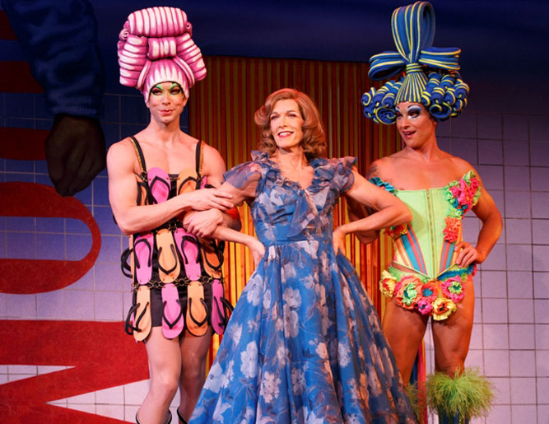
COSTUME DESIGN
Purpose of Costume Design:
Reflect the production concept
Exhibits a unity of style
Reflects the personality, nature and function of the character.
Priscilla Queen of the Desert
http://youtu.be/lbRy6OB2_3w

Slide 3
ESSENTIAL QUESTIONS
What precautions are necessary to insure the safety of the performers?
How do the elements of Costume Design work together to realize the director’s vision?

Slide 4
COSTUME SAFETY
ALWAYS KEEP COSTUMES IN GOOD CONDITION.
NEVER EAT OR DRINK NEAR OR WHILE WEARING ANY COSTUME .
COSTUMES SHOULD BE SAFE FOR THE STAGE AND THE ACTOR.
SOME MATERIALS ARE FLAMMABLE. USE CAUTION WHERE NEEDED.
MAKE SPECIAL NOTES IF BORROWED, RENTED, OR OWNED

Slide 5
COSTUME SAFETY
LABEL ALL NEW AND EXISTING COSTUMES WITH: PCH THEATRE.
NEVER ALTER A COSTUME WITHOUT PRIOR APPROVAL.
RETURN ALTERED COSTUMES TO THEIR ORIGINAL STATE BEFORE STORING.
LAUNDER COSTUMES AFTER SIGNIFICANT USE, BEFORE STORING.
WHEN STORING COSTUMES: 1. return to the correct cabinet 2. use the correct hanger 3. keep covered if possible

Slide 6
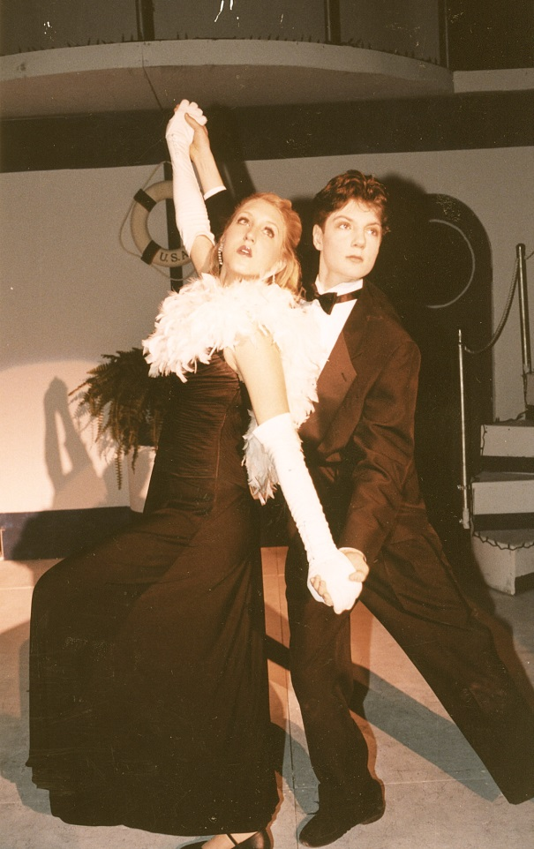
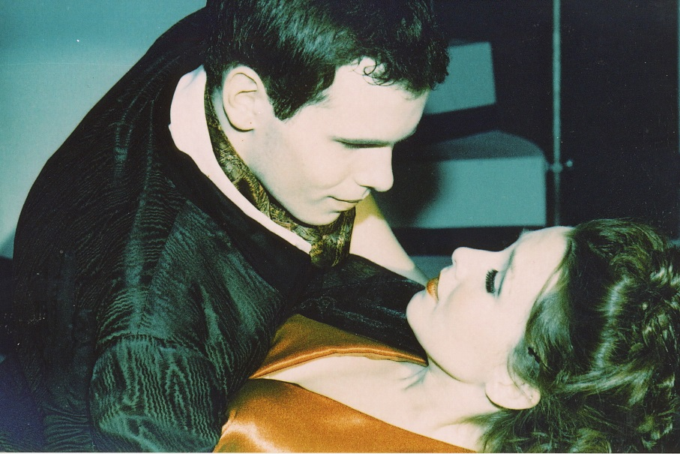
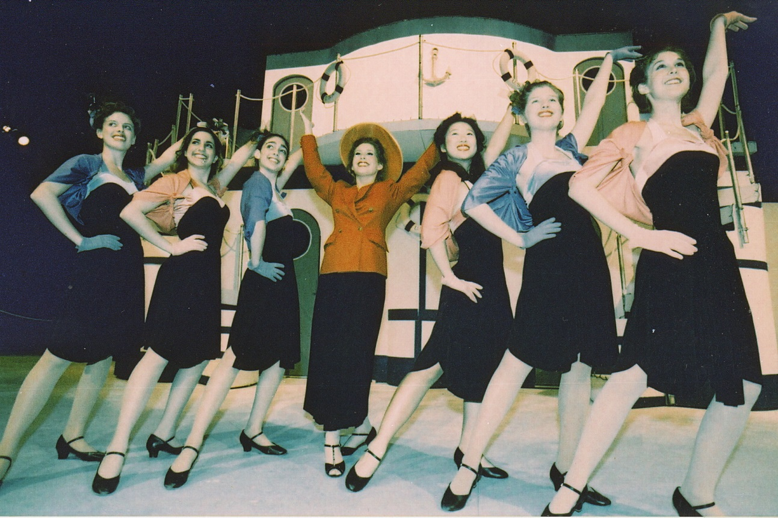
COSTUME DESIGN
Anything Goes
CONCEPTUAL CONSIDERATIONS
Don’t be too stereotypical (gangster in black)
Show the character’s evolution
Stylization – adapt reality to concept
Interpretation of the period – use details, color and fabrics

Slide 7
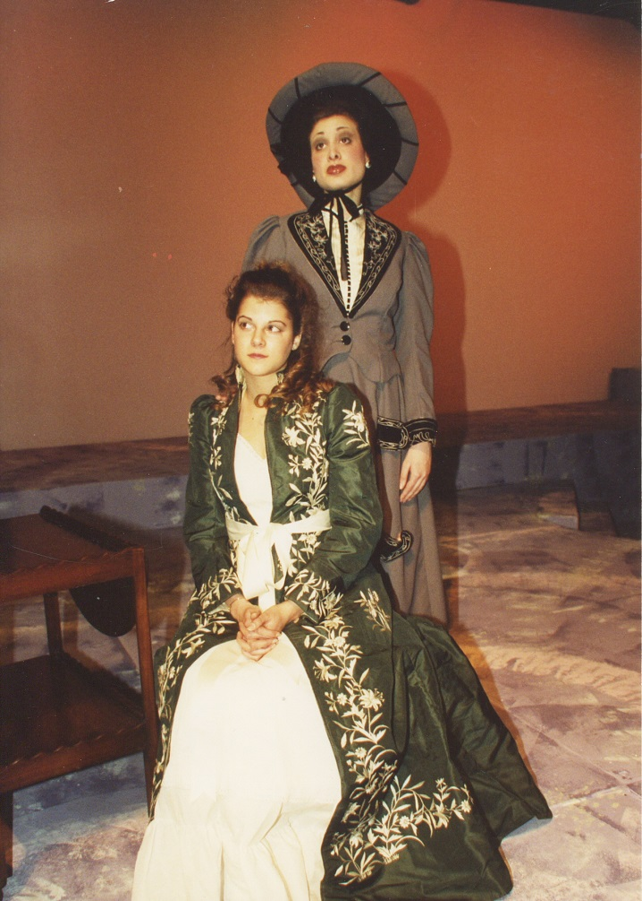
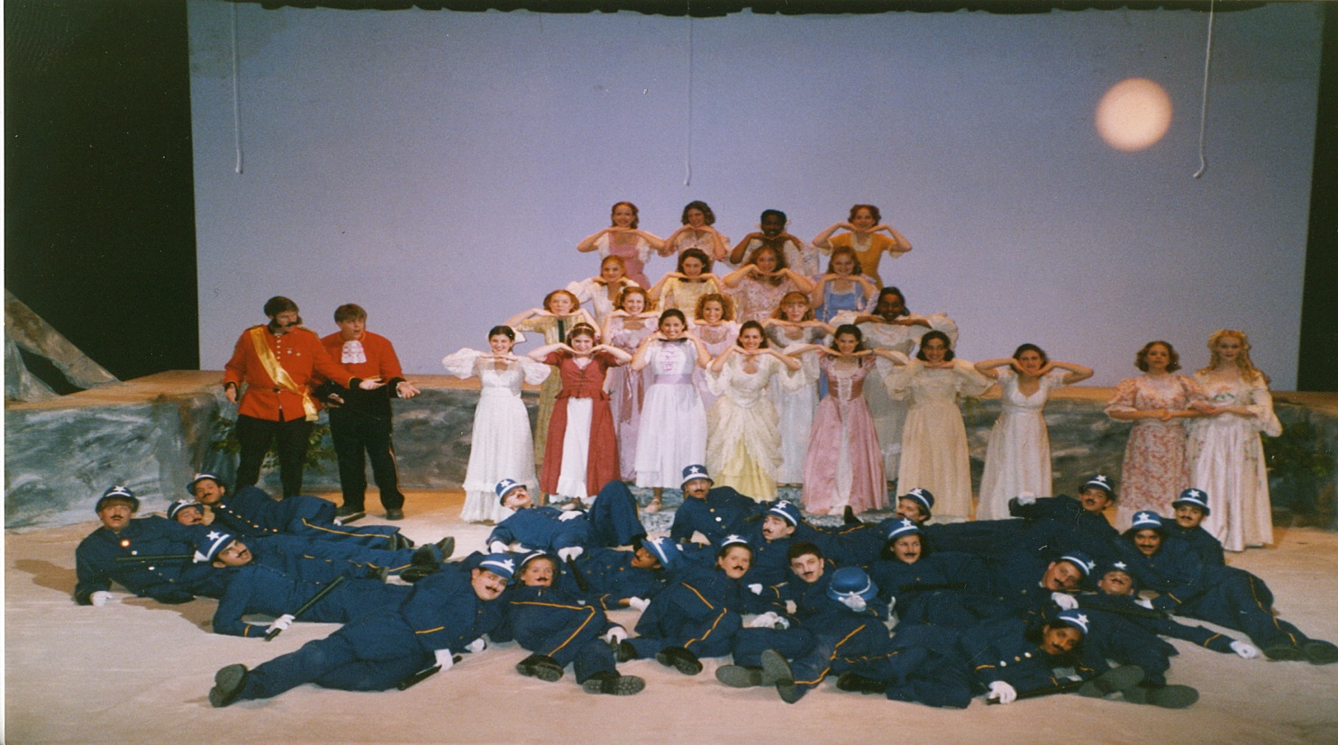
COSTUME DESIGN
PRACTICAL CONSIDERATIONS
Needs of the actor
Theatre size & shape
Budget
Work force
Resources
  Renting
  Buying
  Borrowing
  Renovating
  building
A little Night Music
The Pirates of Penzance

Slide 8
ELEMENTS OF DESIGN
LINE
Angled, jagged, straight, curved or combination?
SHAPE
outlines or silhouettes?
any reoccurring objects?
TEXTURE
smooth=orderly, finished, sleek, elite,
rough=harsher, chaotic, poor, earthy,
MASS
spatial arrangement of the stage
Chaotic, spacious or varied?
heavy or light?
COLOR
Any reoccurring colors?
Do colors contradict or compliment the overall feeling or mood of the script?

Slide 9
PRINCIPLES OF COMPOSITION
UNITY
What is it that connects the show together?
theme, color, feeling, shape? character? An idea?
HARMONY
Harmonious vs inharmonious?
CONTRAST
contradict your visual theme
VARIATION
varying any of the design elements of a given pattern
BALANCE / PROPORTION
symmetrical vs asymmetrical?
EMPHASIS
direct the audience’s attention - giving accent to : a part of a the stage, costume, actor,

Slide 10
COSTUME DESIGN PRODUCTION
COSTUME DESIGNER
  Costume Research
  Costume Notes
  Costume Plot
  Costume Renderings
COSTUME CREW
  Costume Build, Buy, Rent, Borrow
WICKED; Costume Design & build
http://youtu.be/UIpRPv0Cfkw
HOW TO SUCCEED; Designer
http://youtu.be/3aC57QFzysU
THE LION KING; Discover costumes
http://youtu.be/hYAph4qI4sg

Slide 11
COSTUME DESIGN PROJECT
COSTUME DESIGN PRODUCTION
Costume Research
Costume Notes
Costume Plot
COSTUME DESIGN APPLICATION
Sketch a color rendering of the major characters in your play.
Include swatches
List all accessories

Slide 12
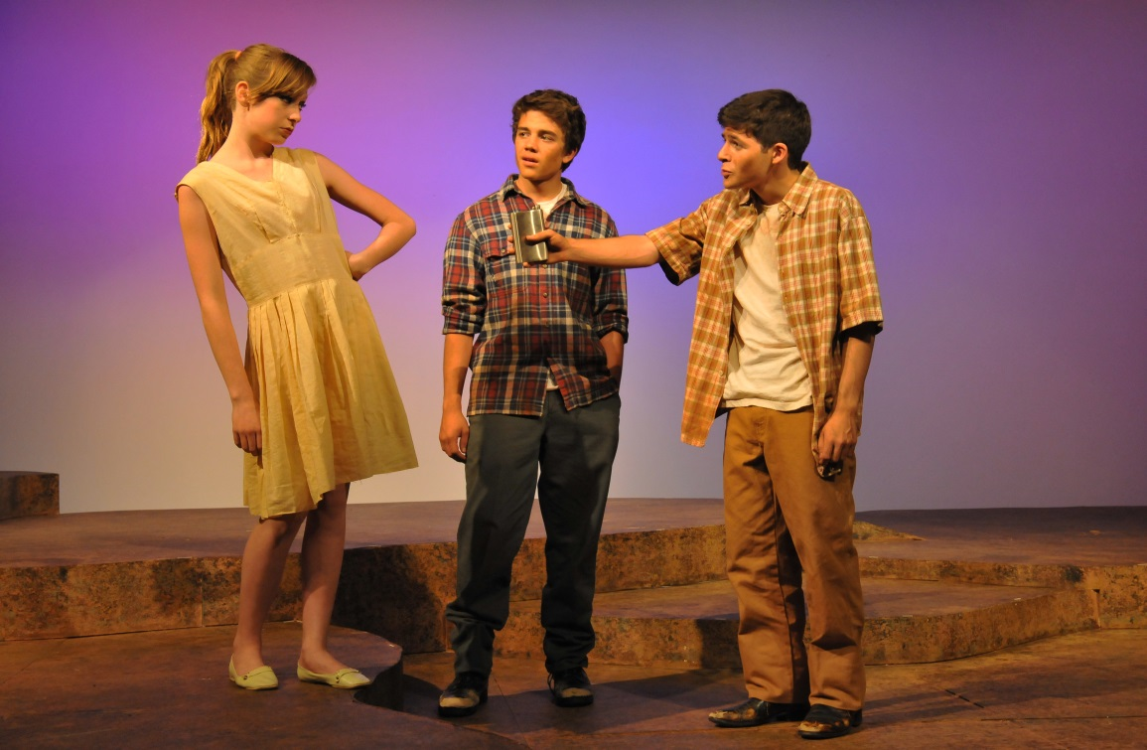
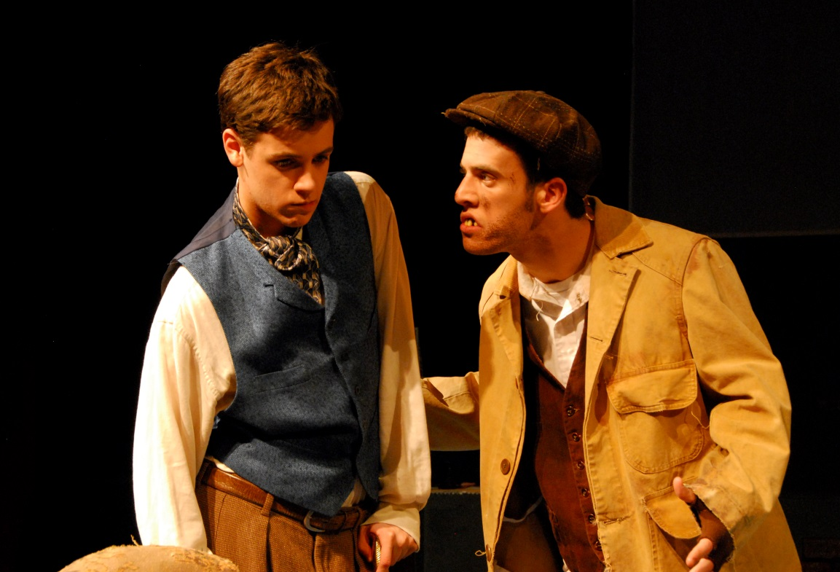
COSTUME RESEARCH
OBJECTIVE INFORMATION
Given Circumstances
Character Information
  Age
  Sex
  Socioeconomic status
  Occupation
  Character’s Dialogue
The Diviners
The Elephant Man

Slide 13
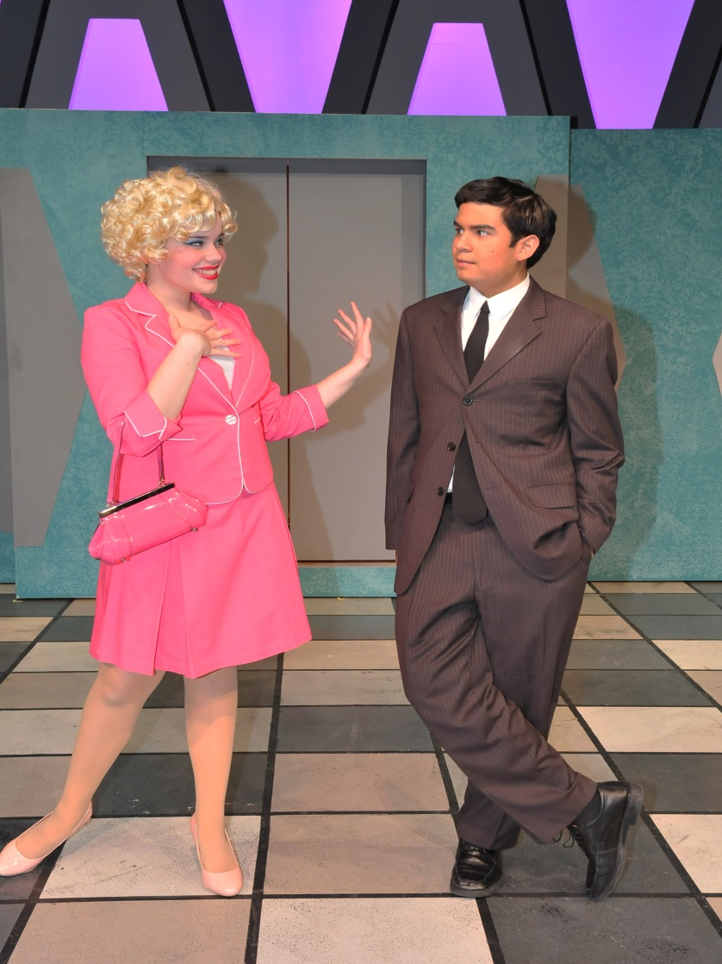
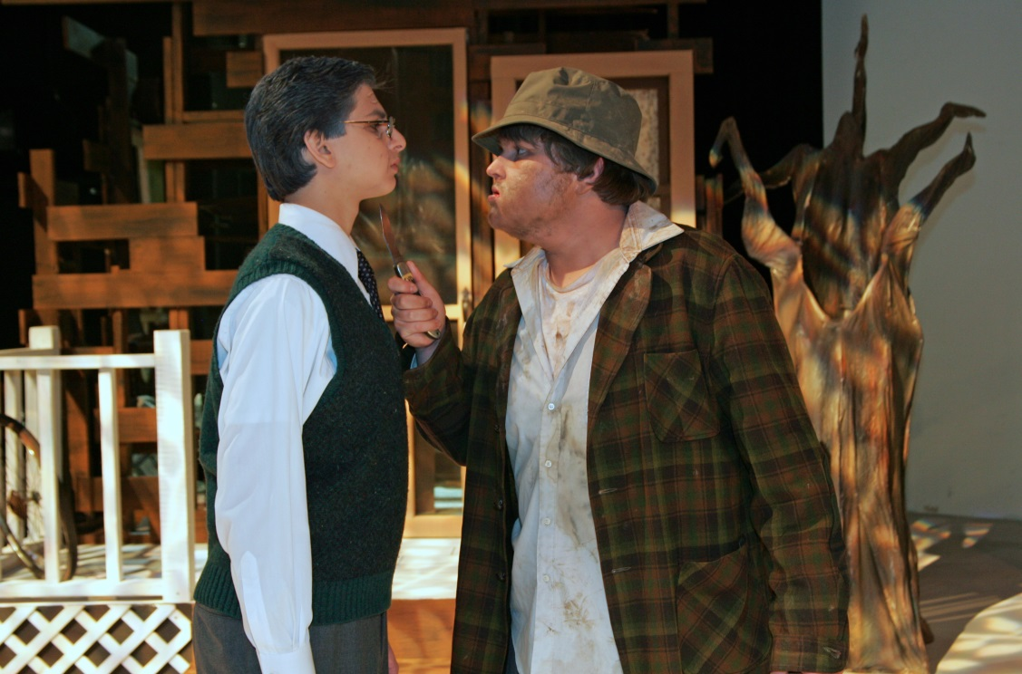
COSTUME RESEARCH
PSYCHOLOGICAL INFORMATION
Style: baggy jeans, pants legs rolled up, inside out shirt
Color/Emotional State: depressed-dark; cheerful-bright
Texture: jeans: cowboys vs. skaters vs farmers vs. business/casual man w/ jacket
How To Succeed in Business Without Really Trying
To Kill A Mockingbird

Slide 14
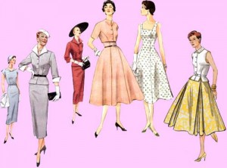
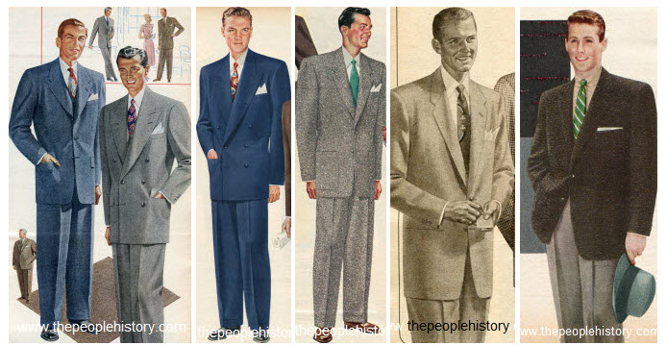
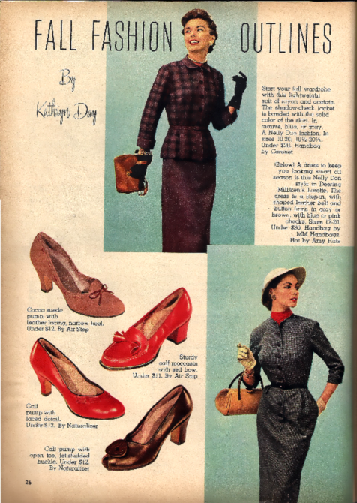
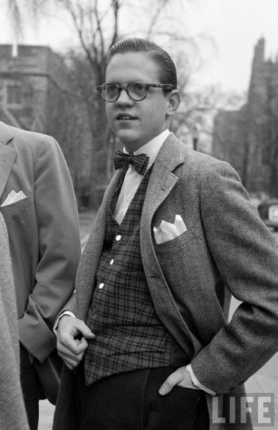
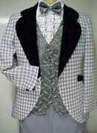
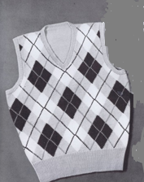
RESEARCH EXAMPLE (1953)

Slide 15
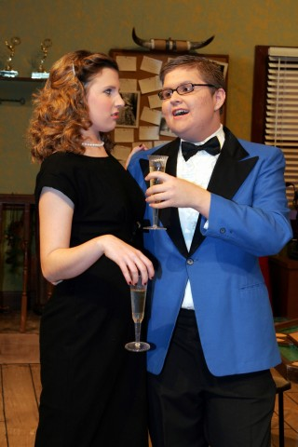
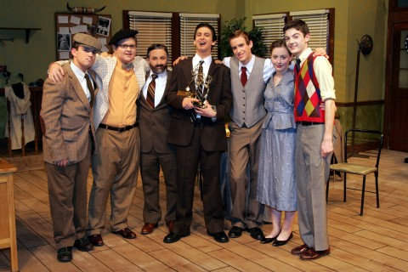
COSTUME RESEARCH
Laughter on the 23rd Floor

Slide 16
COSTUME NOTES
Record anything that relates to or about the costumes in the dialogue, on the NOTES chart.
These are the “have to’s” the musts!
Pg# | Char | Age | Occ | Notes
5 | Anne | 45 | waitress | Exhausted and messy
12 | Dan | 57 | owner | Silk suit “perfectly dressed”
18 | Maude | 88 | Aunt | “outlandish taste in fashion”

Slide 17
COSTUME PLOT
The plot is a way to track a character’s costume from beginning to end.
Now is where you should be more creative, add more detail and your own flare.
Character Names | Scene 1__ Act _1_ | Scene _2_ Act _1_
Anne | White shirt, black pants, white apron | same
Dan | Grey silk, piece 3-suit, black tie | No jacket
Maude | Brown lace, fur trim dress | Black evening dress

Slide 18
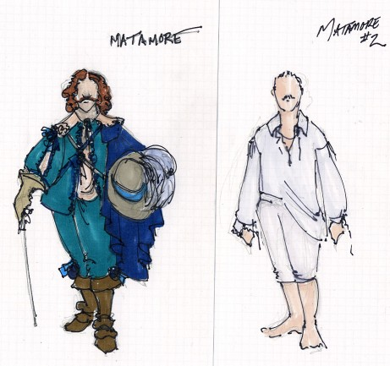
COLOR RENDERING
Color sketch of costume design
Shows all clothing, shoes, and any accessories worn by the character
Attach swatches of the materials used to create the costume at the top of the color rendering.

Slide 19
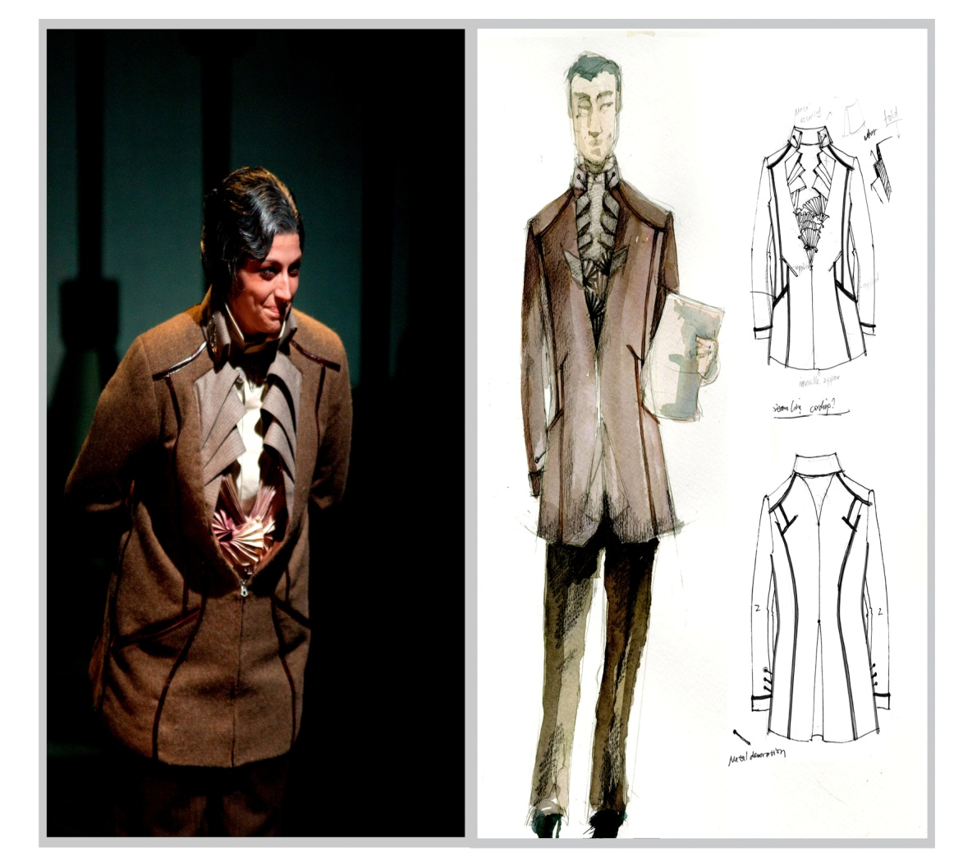
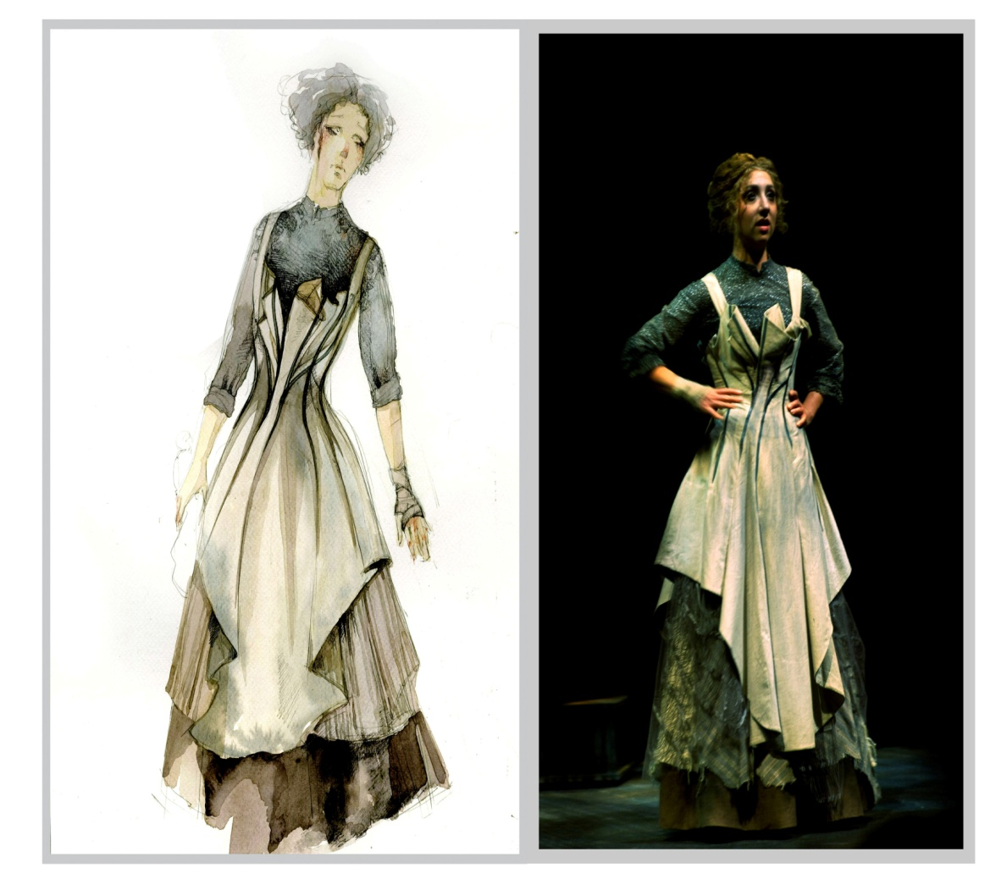
COSTUME RENDERING EXAMPLES

